Slide 1
Cancer Prediction Using Different Types
Algorithms
Presented By:
Md. Ariful Islam Bhuiyan (20152004010)
Md.Taufik Akunjee (20152024010)
Md. Hashikul Islam(20152019010)
Rafiqul Islam (20152010010)

Slide 2
Outlines
Introduction
Objectives
Motivation
Related Work
Methodology
Implementation
Result Analysis
Future Work
Conclusions
Reference

Slide 3
Introduction
Cancer is a group of diseases.
Involving abnormal cell growth and spread to other parts of the body.
These contrast with benign tumors, which do not spread.

Slide 4
Types Of Cancer
There are many types of Cancer
Lung Cancer
Fallopian Tube Cancer
Gallbladder Cancer
Head and Neck Cancer
Hypopharynx Cancer
Kaposi Sarcoma Cancer
Kidney Cancer etc.

Slide 5
Objectives
To analyze the collected data.
To Implement algorithm for prediction of cancer.
To identify best classifier algorithm.
To predict a person have cancer or not.
To predict types of cancer.

Slide 6
Motivation
Reduce the number of people who died every year.
Relief the people from anxiety.
Giving people hope of living.
Reduce the number of affected people
Helps the people to know their cancer risk with low cost.

Slide 7
Related Work
Ada et al [1] made an attempt to detect the lung tumors from the cancer images and supportive tool is developed to check the normal and abnormal lungs and to predict survival rate and years of an abnormal patient so that cancer patients lives can be saved.
Charles Edeki et al [2] suspects that none of the data mining and statistical learning algorithms used to breast cancer dataset outperformed the others in a certain process that it could be exposed the optimal algorithms and none of the algorithms accomplished poorly as to be dispelled from future prophecy pattern in breast cancer survivability tasks.
Ritu Chauhan et al [3] focuses on clustering algorithm such as HAC and K-Means in which, HAC is applied on K-means to determine the number of clusters. The quality of cluster is improved, if HAC is applied on K-means.

Slide 8
Related Work(cont.)
S M Halawani et al [4] suggests that probabilistic clustering algorithms performed well than hierarchical clustering algorithms in which almost all data points were clustered into one cluster, may be due to inappropriate choice of distance measure.
Labeed K Abdulgafoor et al [5] wavelet transformation and K- means clustering algorithm have been used for intensity based segmentation.
Sudhir D. Sawarkar et al [6] in their research they used SVM and ANN on the WBC data. The outcome of SVM and ANN prognosis models were formed relatively more appropriate than the human being. The 97% high accuracy of these prediction patterns can be used to accept the decision to escape biopsy.

Slide 9
Methodology
Data Source
Diagram

Slide 10
Data Source
In the case of predicting cancer, undergoing patient’s data is used.
The cancer patients’ data collected from different sources.
There are 1180 information and it contains 86 attributes and 1 class attributes.
We used Naive Bayes, J48, KNN and K-Star classifier in WEKA toolkit.

Slide 11
Data Source
Variables | Data distribution | Types
Age | Minimum=20 years Maximum=73 years Mean=46.714 | Numeric
Gender | Male=607 Female=573 | Nominal
Abdominal Pain | Positive Value=373 Negative Value=807 | Nominal
Urinary Symptoms | Positive Value=143 Negative Value=1037 | Nominal

Slide 12
Data source
Variables | Data Distribution | Types
Fatigue | Positive Value=486 Negative Value=664 | Nominal
Back pain | Positive Value=105 Negative Value=1075 | Nominal
Rash | Positive Value=68 Negative Value=1112 | Nominal
Fever | Positive Value=270 Negative Value=910 | Nominal

Slide 13
Data source
Variables | Data Distribution | Types
CT Scan | Positive Value=601 Negative Value=579 | Nominal
MRI | Positive Value=425 Negative Value=755 | Nominal
Blood Test | Positive Value=369 Negative Value=811 | Nominal
Urine Test | Positive Value=134 Negative Value=1046 | Nominal

Slide 14
Data source
Variables | Data Distribution | Types
Class | Lung cancer=49 Fallopian Tube Cancer=39 Gallbladder Cancer=29 Kidney Cancer=38 Liver Cancer=41 Prostate Cancer=46 Blood Cancer=46 Brain Cancer=40 etc | Nominal

Slide 15
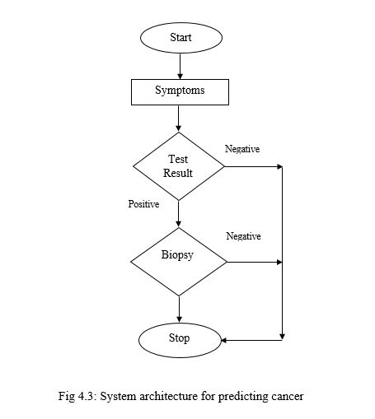
Diagram

Slide 16
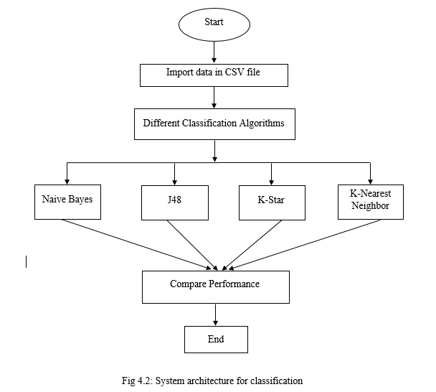

Slide 17

Implementation
Accuracy $:\frac{TP+TN}{P+N}$
Error Rate :$\frac{FP+FN}{P+N}$
Recall : $\frac{TP}{p}$

Slide 18
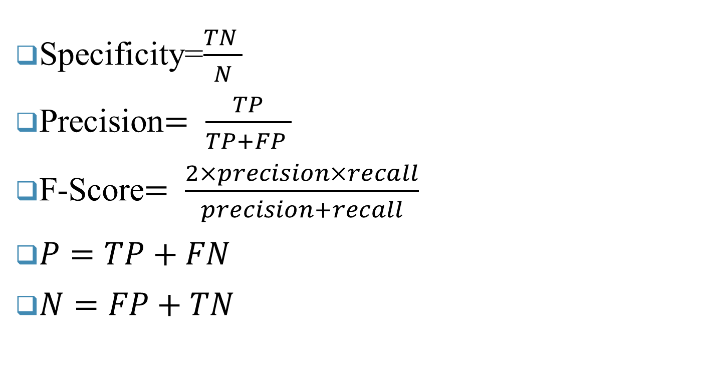
Implementation
Specificity=$\frac{TN }{N}$
Precision$= \frac{TP}{TP+FP }$
F-Score$= \frac{2×precision×recall}{precision+recall}$
$P=TP+FN$
$N=FP+TN$

Slide 19
Result Analysis
Accuracy
Error Rate
Sensitivity
Specificity
Precision
F-Score
Average Table
Comparison Table

Slide 20
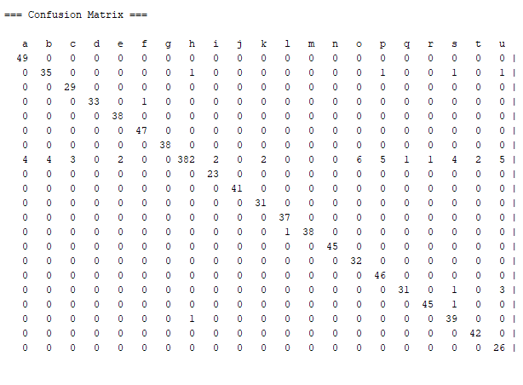
Confusion Matrix

Slide 21
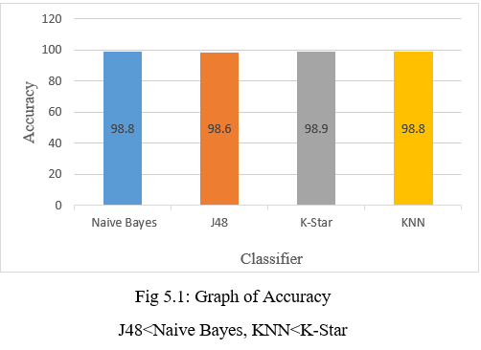
Graph of Accuracy

Slide 22
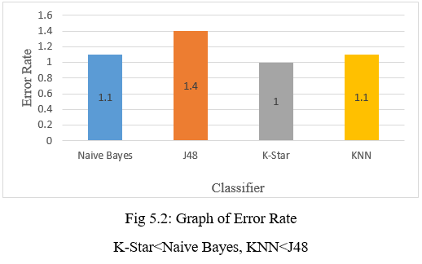
Graph of Error Rate

Slide 23
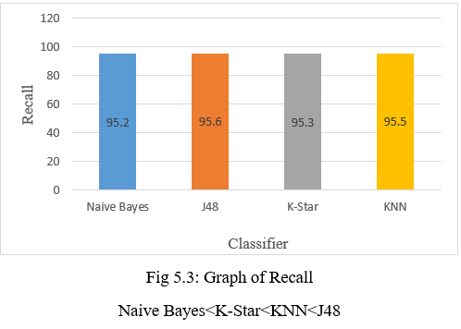
Graph of Recall

Slide 24
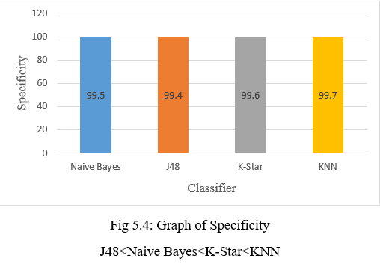

Slide 25
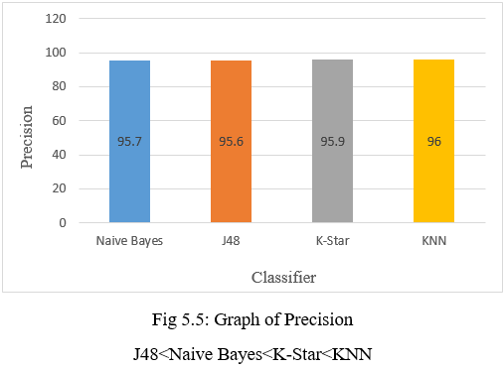

Slide 26
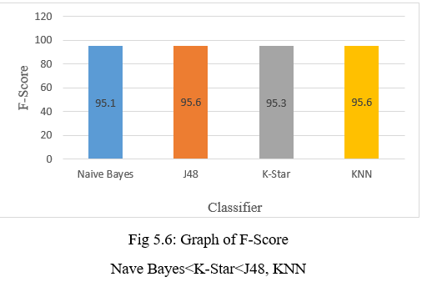

Slide 27
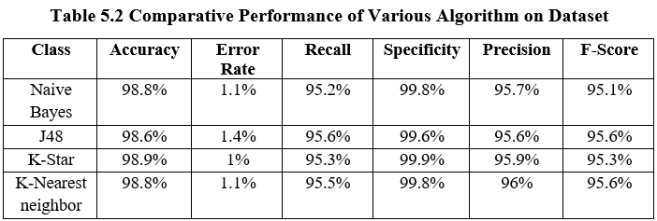
Average Table

Slide 28
Comparison Table
Existing Work
Author | Year | Method | Accuracy
Charles Edeki and Shardul Pandya | 2012 | Logistics Regression, J48,ANN | Logistics Regression 71%, J48 70.17%, ANN 72.94%
Ritu Chauhan | 2010 | K-Means, HAC | It shows a graph.
Shar A. Moktar and Alaa M. Elsayad | 2013 | CAID, ANN, SVM | CAID 81.43%, ANN 81.13%, SVM 83.66%

Slide 29
Comparison Table Cont.
Our Work
Author | Year | Method Used | Accuracy
Md. Ariful Islam Bhuiyan, Md. Taufik Akunjee, Md. Hashikul Islam, Rafiqul Islam | 2019 | Naive Bayes, j48, k star, KNN | Naive Bayes 98.8%, j48 98.6%, k star 98.9%, KNN 98.9%.

Slide 30
Conclusion
Based on medical research dataset.
Smoking ,over weight is one of the main reason of cancer.
Used 20 types of cancer.
Four Classifier algorithm is used in this purpose.
K-Star works best among them.

Slide 31
Future Work
In future we will try to add more innovation to a large improvement.
We will try to extend dataset.
We will try to develop new models prediction and survivability.

Slide 32
Reference
[1] Ada and Rajneet Kaur “Using Some Data Mining Techniques to Predict the Survival Year of Lung Cancer Patient” International Journal of Computer Science and Mobile Computing, IJCSMC, Vol. 2, Issue. 4, April 2013, pg.1 – 6, ISSN 2320–088X
[2] Charles Edeki "Comparative Study of Data Mining and Statistical Learning Techniques for Prediction of Cancer Survivability" Mediterranean Journal of Social Sciences Vol 3 (14) November 2012, ISSN: 2039-9340.
[3] Ritu Chauhan "Data clustering method for Discovering clusters in spatial cancer databases" International Journal of Computer Applications (0975-8887) Volume 10-No.6, November 2010.
[4] S M Halawani "A study of digital mammograms by using clustering algorithms" Journal of Scientific & Industrial Research Vol. 71, September 2012, pp. 594-600.
[5] Labeed K Abdulgafoor "Detection of Brain Tumor using Modified K-Means Algorithm and SVM" International Journal of Computer Applications (0975 – 8887) National Conference on Recent Trends in Computer Applications NCRTCA 2013
[6] Sudhir D., Ghatol Ashok A., Pande Amol P. (2006). “Neural Network aided Breast Cancer Detection and Diagnosis.” 7 th WSEAS International Conference on Neural Networks, 2006.

Slide 33


